Slide 1
Credit Card Fraud Detection
Infosys SpringBoard - AI
By : Prem Raj P

Slide 2
Problem Statement
Objective: Classify credit card transactions into fraudulent and non-fraudulent categories using historical transaction data.
Dataset: Kaggle's Credit Card Fraud Detection Dataset.

Slide 3
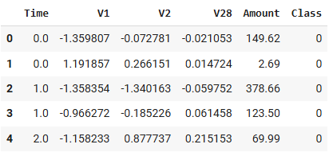
Dataset Overview
Dataset Information:
Total Data’s; 5,55,458
Total Rows: 41,683
Columns: 31
Class Distribution:
Non-Fraudulent Transactions: 41,574
Fraudulent Transactions: 108

Slide 4
Data Pre-processing
Steps Taken:
Identified and handled null values.
Scaled numerical features using RobustScaler.
Balanced class distribution using SMOTE (Synthetic Minority Oversampling Technique).
Result: Resampled class distribution: 33,259 for each class.

Slide 5
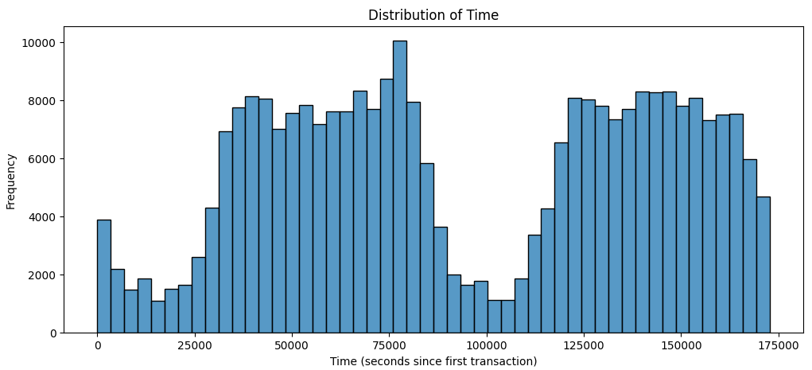
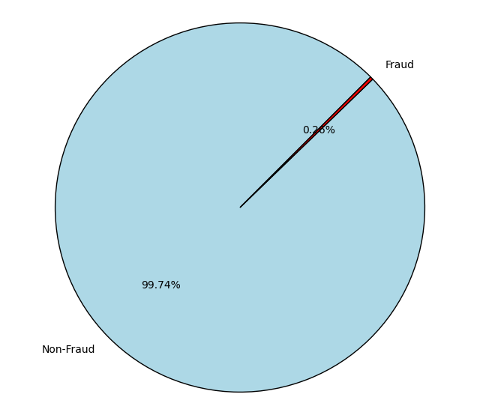
Exploratory Data Analysis
Key Findings:
Fraudulent transactions are sparse.
Distribution of transaction time and amount shows variability.
Visualizations:
Fraudulent Transactions Over Time
Class Distribution

Slide 6
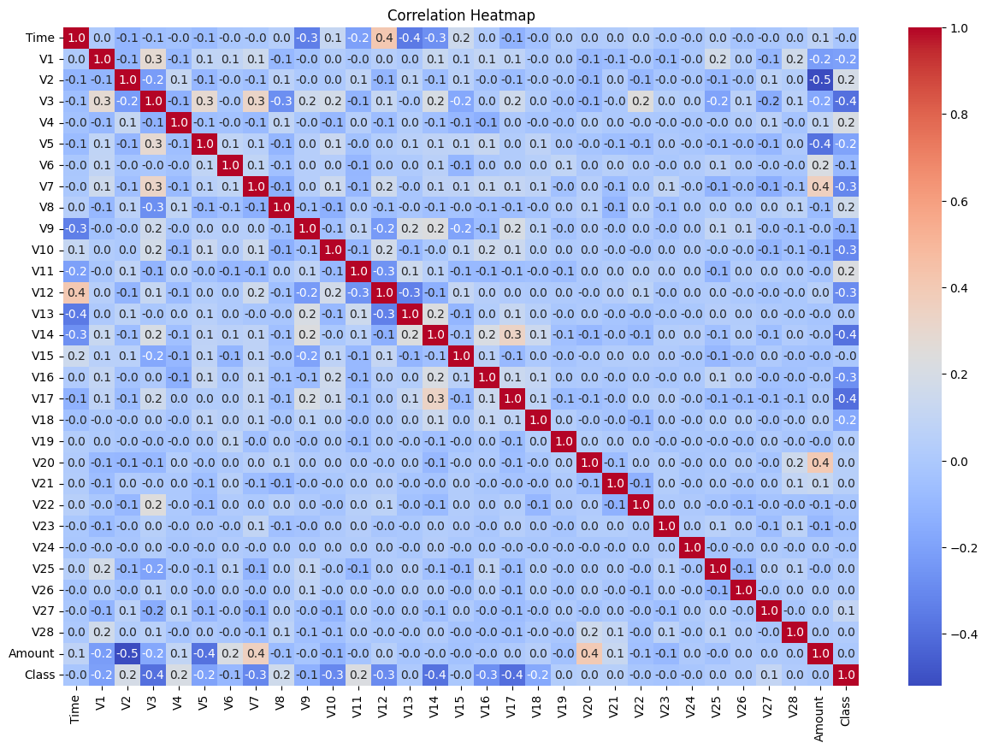
Feature Selection
Methods Used:
Correlation Heatmap:
Used to analyze correlations between features and the target variable.
Helped identify features most related to fraudulent transactions.
Recursive Feature Elimination (RFE):
Iteratively removed less significant features based on model performance.
Focused on reducing redundancy and improving model interpretability.

Slide 7
Model Selection
Logistic Regression – 97.40
Random Forest – 99.94
Decision Tree – 99.65
Support Vector Machine – 99.94
XGBoost – 99.95
LightGBM – 99.35
CatBoost – 99.96

Slide 8
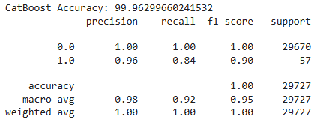
Results Summary
Best Performing Models:
CatBoost:
Accuracy: 99.95

Slide 9
Thank You

